Slide 1

MACHINE LEARNING
BY-
AMAN SINGH
PRIYANSHU SINGH

Slide 2
TITLE
What is Machine Learning?
Types of Machine Learning
Machine Learning Algorithms
Benefits of Machine Learning
Limitations of Machine Learning
Conclusion

Slide 3
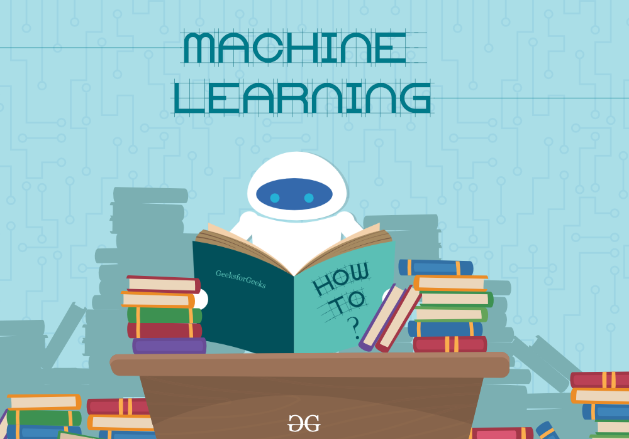
What is Machine learning
Machine Learning is an area of Artificial Intelligence that enables computers to learn from data without being explicitly programmed. It is a form of predictive analytics that uses algorithms to identify patterns in data and make decisions.
Machine Learning can be used to make decisions and predictions in a variety of fields, from finance to healthcare and beyond. It is used to automate processes and improve the efficiency of data-driven tasks.

Slide 4
Types of Machine learning
There are three main types of Machine Learning: supervised, unsupervised, and reinforcement. Supervised Learning is used to train models on labeled data, while unsupervised Learning is used to discover patterns in unlabeled data.
Reinforcement Learning is a form of Machine Learning where an agent is trained to take actions in an environment to maximize rewards. This type of Machine Learning is often used in robotics and autonomous systems.

Slide 5
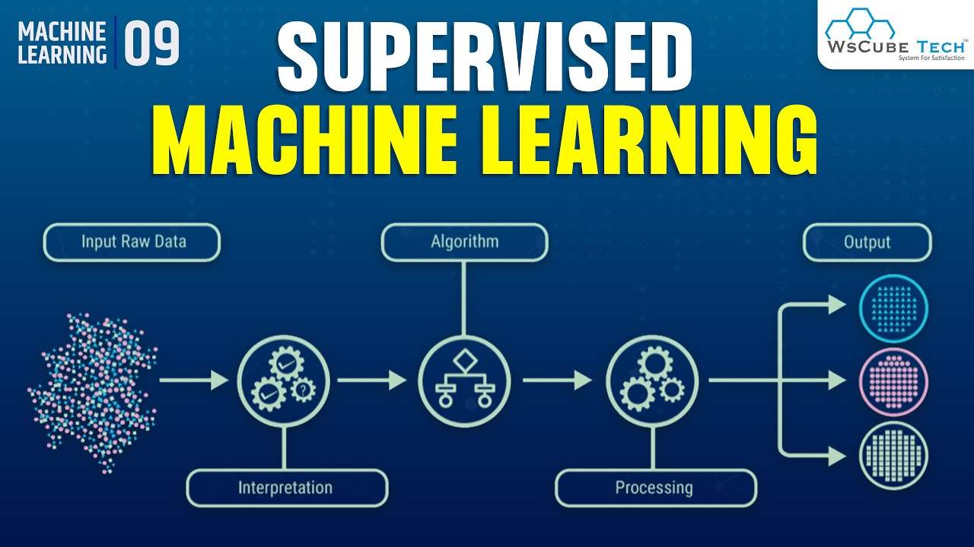
SUPERVISED LEARNING
Supervised learning is a machine learning technique where an algorithm learns to make predictions or classifications by being trained on labeled examples. The algorithm is given input data and corresponding output data, and adjusts its parameters until it can accurately predict the output for new input.

Slide 6
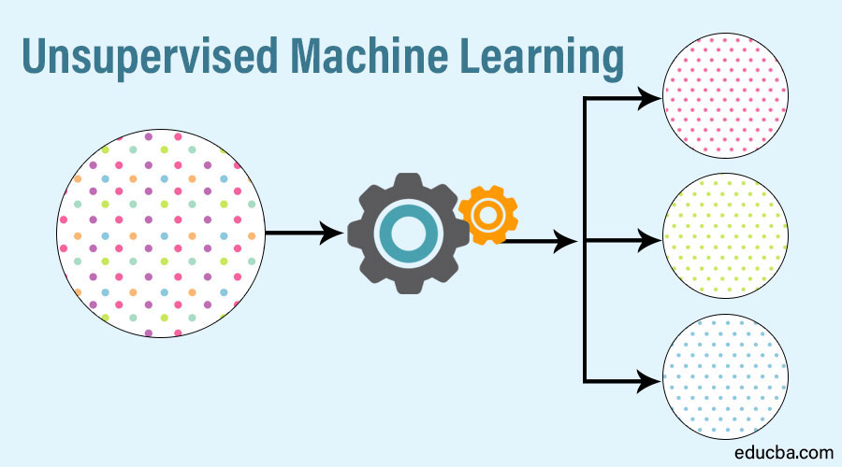
UN-SUPERVISED LEARNING
Unsupervised learning is a type of machine learning where the algorithm learns to identify patterns or relationships in the data without being explicitly trained on labeled examples. The algorithm is given input data and must find structure or patterns on its own, such as clustering similar data points or discovering latent features.

Slide 7
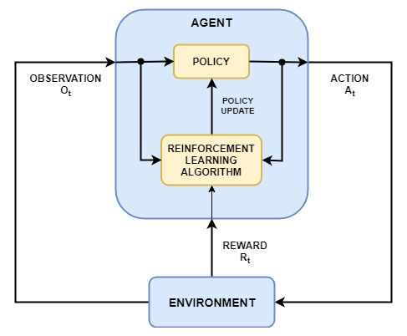
REINFORCEMENT LEARNING
Reinforcement learning is a machine learning technique where an agent learns to make decisions by interacting with an environment and receiving rewards or punishments for its actions. The agent learns to maximize its reward over time by exploring different actions and learning which ones lead to positive outcomes. This approach has been used to develop AI systems that can play complex games, control autonomous vehicles, and even manage energy grids

Slide 8
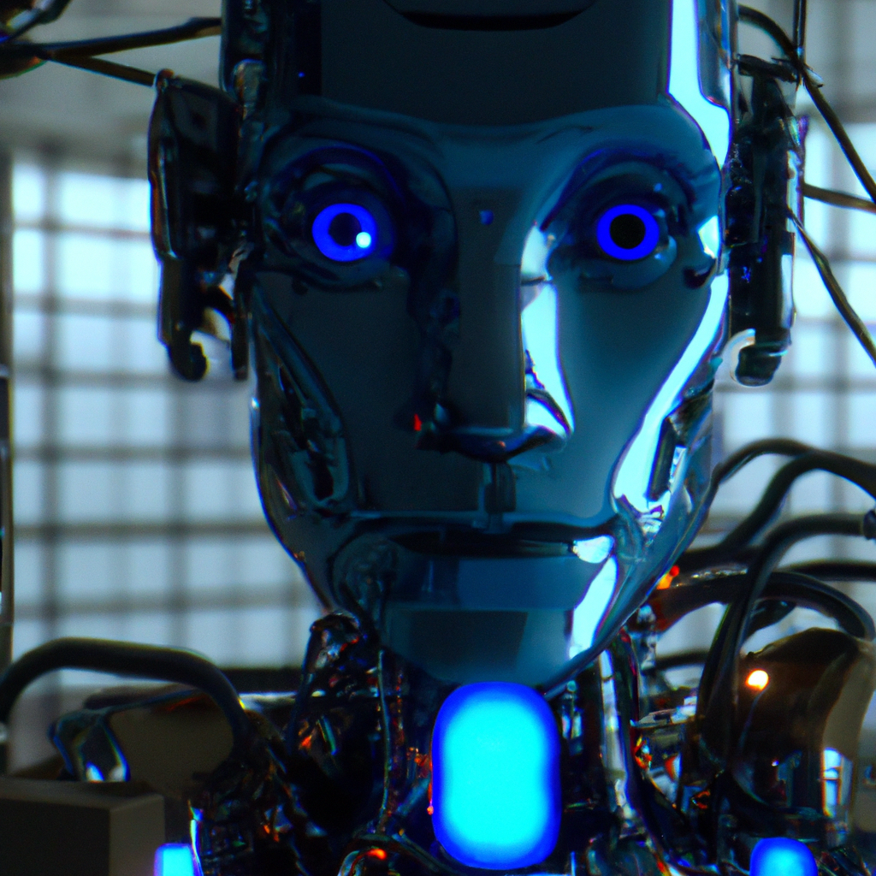
Benefits of Machine Learning
Machine Learning can be used to automate processes and improve the efficiency of data-driven tasks. It can also be used to make decisions and predictions in a variety of fields, from finance to healthcare and beyond.
Machine Learning can also be used to identify patterns in data that would otherwise be too complex for humans to detect. This can lead to improved decision-making and better predictions.

Slide 9
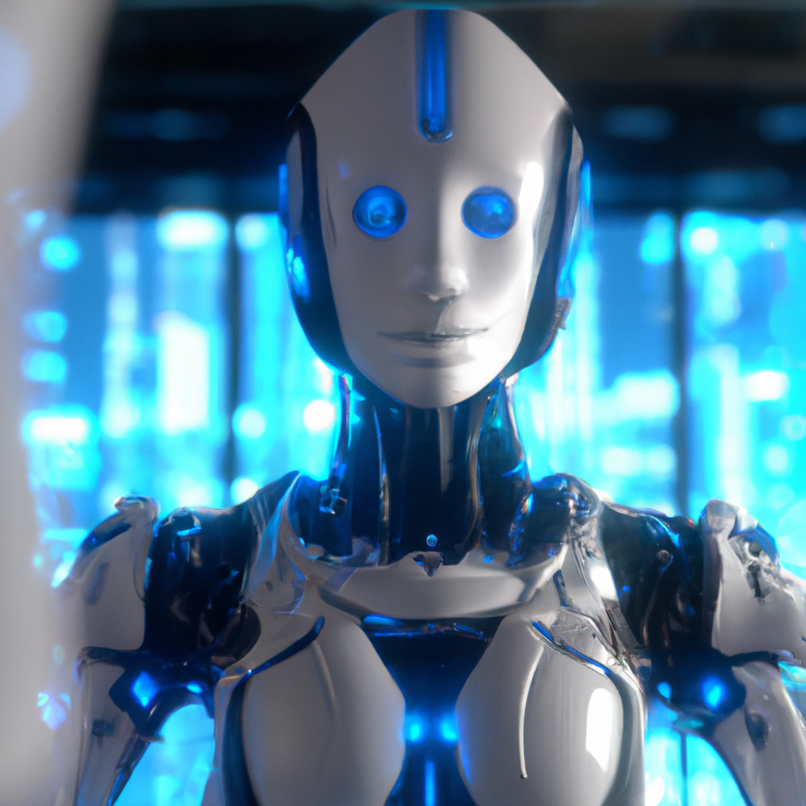
LIMITATION MACHINE LEARNING
Machine Learning is limited by the quality of the data it is given. If the data is noisy or incomplete, the model may be unable to make accurate predictions or decisions.
Machine Learning is also limited by the algorithms used to build the model. Different algorithms are better suited for different types of data and tasks, so it is important to choose the right algorithm for the job.

Slide 10
CONCLUSION
Machine Learning is an area of Artificial Intelligence that enables computers to learn from data without being explicitly programmed. It is a powerful tool that can be used to automate processes and improve the efficiency of data-driven tasks.
However, Machine Learning is limited by the quality of the data it is given and the algorithms used to build the model. It is important to choose the right algorithm for the job in order to get the best results.

Slide 11


